Slide 1
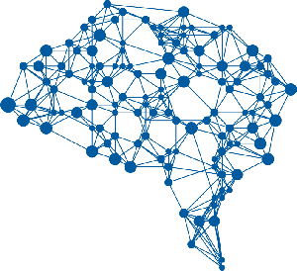
Introduction to Deep Learning

Slide 2
Deep Learning
Deep learning is a subfield of machine learning technique that uses deep neural networks
Deep neural networks are artificial neural networks having many layers
Different applications:
Speech recognition
Computer vision
Natural language processing
Signal processing
Machine Learning
Deep Learning
Notes:
Introduction to deep learning

Slide 3

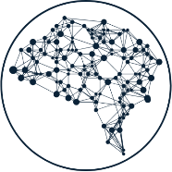


Key developments
Proper evaluation of machine learning methods
Deeper and larger network architectures
Resurgence of Neural Network methods
Accelerated training using GPU techniques
Vastly increased amounts of data
Notes:
The four key developments that have played a crucial role in the resurgence of neural networks

Slide 4
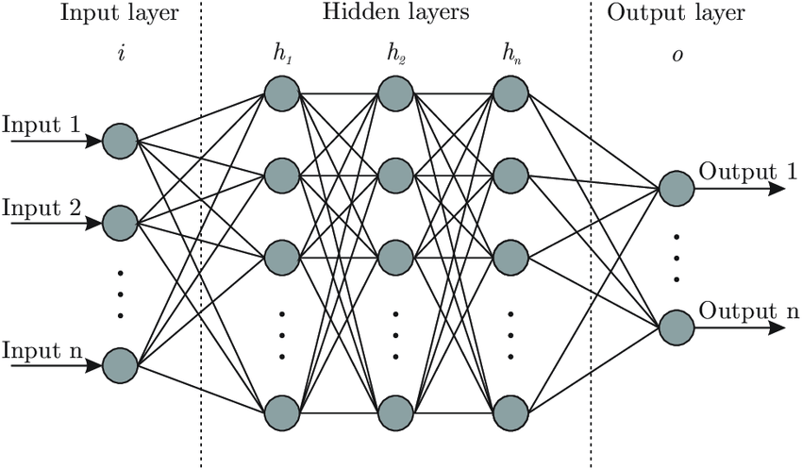
Deep Neural Networks
Deep neural networks consist of many layers
The input layer is responsible for receiving the inputs
The hidden layers reside between input and output layers
The output layer is responsible for producing the final result
All neurons in a layer connect to all the neurons in the previous layer
Fully connected layer
The strength of the connection between any two neurons is given by a numeric weight value
Notes:
Deep Neural Networks architecture.
See 1.d for details about a shallow neural network and how a value passed to a neuron is calculated

Slide 5

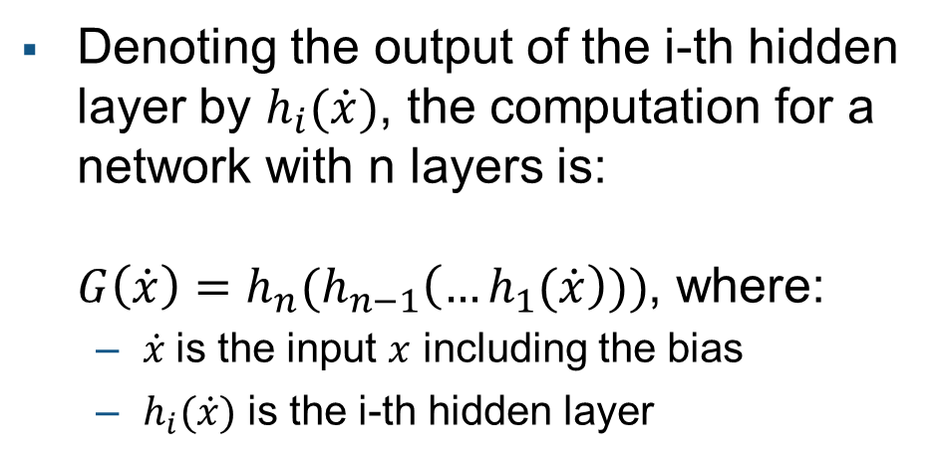

The computation for a Deep Neural Network
Denoting the output of the i-th hidden layer by $h_{i}(\dot{x})$, the computation for a network with n layers is: $G\left(\dot{x}\right)=h_{n}(h_{n−1}\left(…h_{1}(\dot{x}\right)))$, where:
$\dot{x}$is the input $x$ including the bias
$h_{i}(\dot{x})$ is the i-th hidden layer
$$h_{1}(\dot{x})$$
?
Notes:
Deep Neural Networks architecture.
Information is passed or fed forward from one layer to the next.
How is the function h(x) computed?

Slide 6
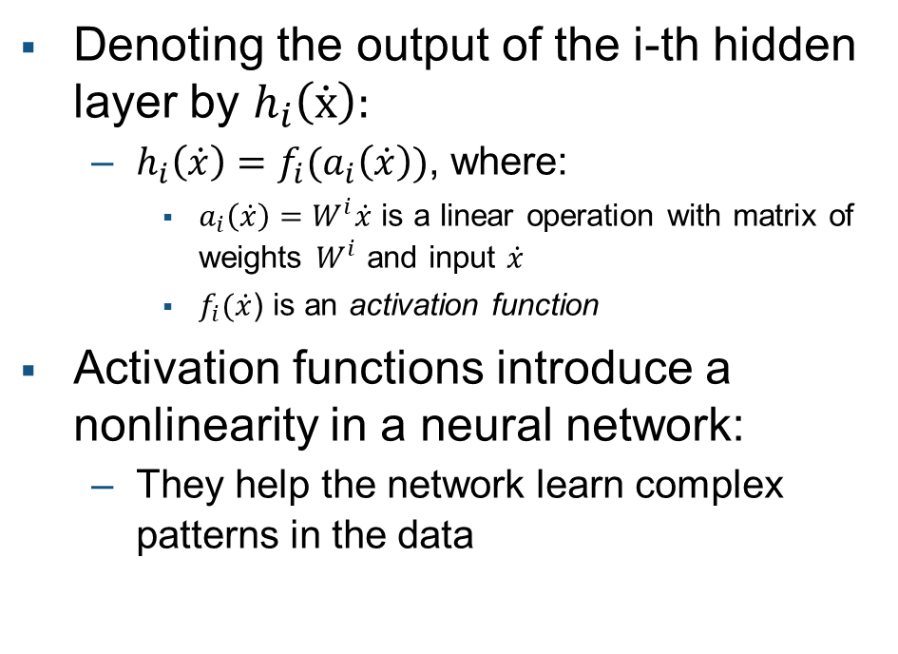
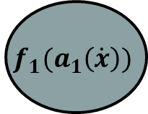
Hidden layer details
Denoting the output of the i-th hidden layer by $h_{i}\left(\dot{x}\right)$:
$h_{i}\left(\dot{x}\right)=f_{i}(a_{i}\left(\dot{x}\right))$, where:
$a_{i}\left(\dot{x}\right)=W^{i}\dot{x}$ is a linear operation with matrix of weights $W^{i}$ and input $\dot{x}$
$f_{i}(\dot{x}$) is an activation function
Activation functions introduce a nonlinearity in a neural network:
They help the network learn complex patterns in the data
$$h_{1}(\dot{x})$$
$$f_{1}(a_{1}\left(\dot{x}\right))$$
Notes:
The value passed to a neuron is calculated by taking all the values of the neurons in the previous layer, multiplying them by the matrix of Weights W (including the biases)
The output from this function is the value passed to the activation function
The weights, biases and activation function determine how inputs are transformed into outputs

